Slide 1
Courtyard Towers
Making a Difference
By: Lindsay Leischner

Slide 2
Introduction
Courtyard Towers is a nursing home/assisted living facility. It is located in Mesa, Arizona and has been helping the elderly since 1989. I picked Courtyard Towers to do my service project because my grandma is currently living there and I also enjoy working with the elderly. Courtyard Towers has 98 employees and 180 residents. On each floor there are 16 residents with 2 caregivers, a nurse, and an activities director.
While observing and volunteering at Courtyard Towers, I got to see elderly making friends and having fun. Unfortunately, I also saw ones by themselves, looking lonely. I chose to go there and do my best to help everyone have fun and feel accepted. I was told by the director that a large percent of residents do not have any visitors; this encouraged me to make an effort to spend more time with the people there and make them feel more valued and important. I wanted to serve them the only way I knew how, my time.

Slide 3
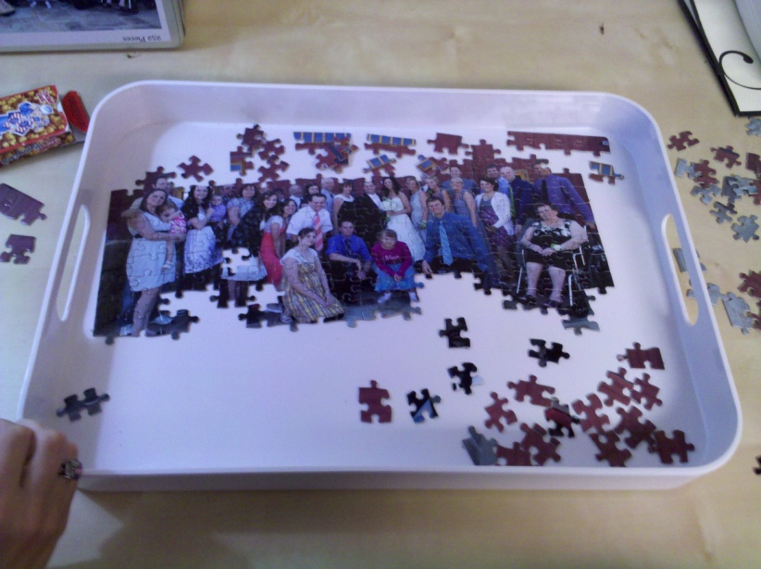
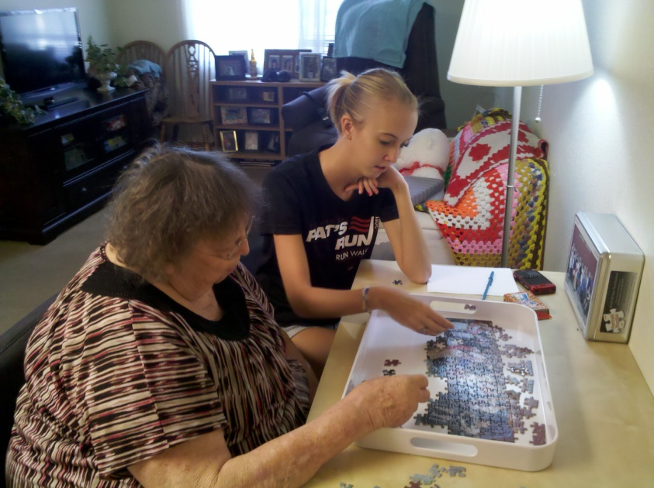
Puzzles!
One of my visits to Courtyard Towers, I spent time with my Grandma working on her favorite puzzle. She has Alzheimer's disease and by working on the puzzle it allows her see and remember everyone who is in her family. The puzzle is a picture of her family at my sister’s wedding.

Slide 4
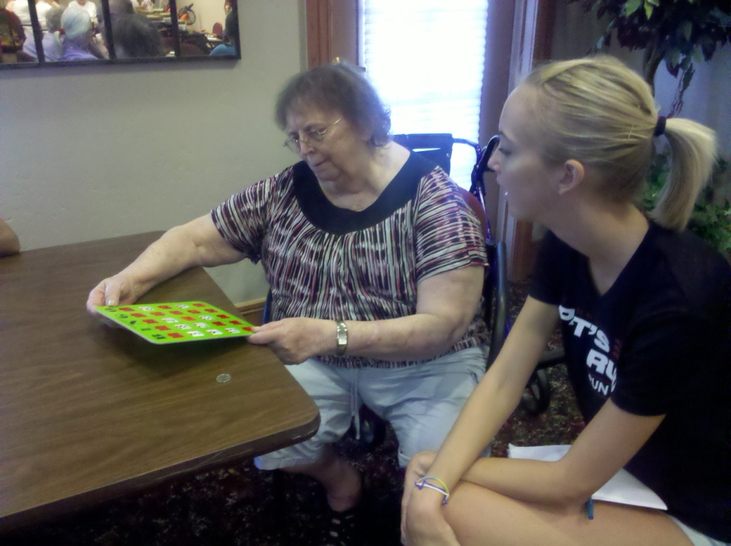
Bingo!
I also played bingo with some of the residents there. Every week a bunch of them get together and play. I was happy when they asked me to play and be apart of their community. They thought it was the coolest thing for a young person to come play and hang out with the older people.

Slide 5
Do you think the issue of neglect or abuse in nursing homes is on the rise or decline?
88% of the Courtyard Towers staff members believe abuse is on the rise!

Slide 6
My Hypothesis and Result
Hypothesis: Nursing home abuse/neglect is on the rise.
Results: “The reported abuses were physical, sexual and verbal. All abuse is on the rise.” Referring to the Congressional Report showing statistics of over 30% of abuse violations in the U.S. (cbs.com).
One of the staff members, Janie, at Courtyard Towers said that “It’s easier for people to hide the abuse or neglect than to report it.”

Slide 7
The Response from Staff members at Courtyard Towers
The bigger the ratio between staff and patient the better chances of neglect happening in nursing homes.
If abuse/neglect is reported, the facility should take steps to prevent it from happening again.
The most common type of abuse is emotional. For example, do this or else you don’t get___.
The director has every staff member take a background check, tests, and a survey on abuse/neglect before hiring the worker.

Slide 8
References
"Nursing Home Abuse Increasing - CBS News." Breaking News Headlines: Business, Entertainment & World News - CBS News. 11 Feb. 2009. Web. 29 July 2011. <http://www.cbsnews.com/stories/2001/07/30/national/main304038.shtml>.

