Slide 1
Nursing Home Neglect/Abuse
The issue behind the scenes
By: Lindsay Leischner
August 1, 2011

Slide 2
Just the Beginning
Nursing home care is an incredible story of some of our country’s problems when it should be our solution.
Nursing home problems doesn’t seem to be getting better but are getting worse.
Nursing care facilities are promoting good care through advertizing and attorney services are identifying abuse and neglect.
While there are thousands of documented cases of abuse and neglect, I will share two disturbing cases.

Slide 3
A few more Introductory Thoughts
We will see some photographs that visualize abuse.
Although we will see some cartoons that may seem funny at first glance but are no laughing matter.
You will see that much has been written about nursing home neglect and abuse.
Statistically you will be saddened by the number of neglect and abuse cases, as well as the different types of abuse.

Slide 4
Nursing Home Overview
“There are approximately 17,000 nursing homes nation wide” (cbs.com).
Over 135 nursing homes in Arizona (Manf, Brand).
Approximately 1.5 million nursing home residents in the United States (cbs.com).

Slide 5
A Painful Story
The following story is so preventable yet leads to a tragic ending.
The following story shows an example of abuse and neglect.
Here is Andrew Clark’s story.

Slide 6
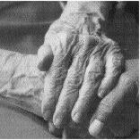
Mr. Clark’s Story
Andrew Clark was a retired attorney who had diabetes and dementia. Mr. Clark went into a private nursing home for his diabetes and Alzheimer’s behavioral problems. Mr. Clark had good behavior and recognized his family. Soon after being in the home he became depressed. He didn’t want to eat and had no interest in watching sports, an interest he always had before.

Slide 7
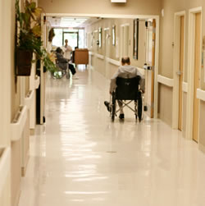
Mr. Clark became frustrated and cried frequently. He didn’t leave his bed much unless forced. The staff told the family he wasn’t adjusting well but should in time. The staff said his Alzheimer’s was advancing but no one had tested him since he had arrived. Shortly after, Mr. Clark remained in bed all day, he refused to leave. Then he started to complain of some pain in his foot. His family noticed a broken blister on his heel.
Abuse
Neglect

Slide 8
When they brought it to the nursing staff, a nurse told the family it was a bedsore. The doctor told them to put cream and a bandage to the sore twice a day, but the doctor never examined Mr. Clark’s foot. Mr. Clark’s wife visited more and noticed no one changed his position in the bed, or tried getting him up. At the end of the month the sore became very deep, painful, and a strange color fluid. The doctor looked at the foot again and requested a surgeon look at it. The surgeon hospitalized Mr. Clark and recommended an above the knew amputation. The surgeon told Mr. Clark’s wife if he had received proper care at the beginning, he would have most likely not have to lost his foot.

Slide 9
My analysis of Mr. Clark’s Story
First of all, all of Mr. Clark's problems could have been prevented if the doctors didn’t neglect his sores. Abuse and neglect effects many people like the patients, the families, and media. Nursing home residents go into the home to get help and care, not abuse or neglect.

Slide 10
Another Sad Story
This story is an example of preventable injury.
Mrs. Jones’s story shows that one small mistake can lead to tragic result.
Here is Mrs. Jones Story.

Slide 11
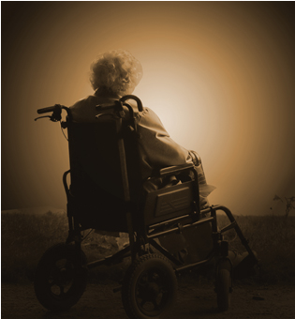
Mrs. Jones’s Story
Mary Jones was a widow living alone when she fell and fractured her hip. After surgery, Mrs. Jones was admitted in a nursing home for a few weeks to recover. A few days after being at the nursing home, her children came for a visit and noticed their mother was drowsy and developing confusion. Before coming to the nursing home Mrs. Jones had no sign of Alzheimer’s. She didn’t want to eat or drink any fluids. The staff said to the family that she was just adjusting to the facility. When the family asked to see a doctor, the nursing staff replied it was unnecessary.

Slide 12
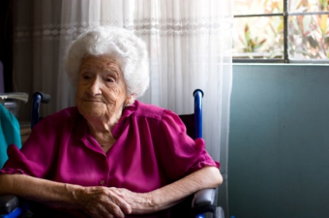
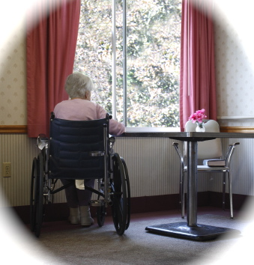
During a visit, Mrs. Jones had developed a cough and her skin looked bad. Her family had noticed she hadn’t eaten or drank anything for several days. The family urged the nurse to call a doctor to examine her, and she responded that she would leave the doctor a message. One of Mrs. Clark’s sons insisted that she call an ambulance, she was reluctant but called. At the hospital she was diagnosed with severe dehydration with pneumonia. The doctors at the hospital explained to the family she was in critical condition because she hadn’t received fluids, and the loss of the fluids put her in organ failure. Because of the loss of fluids, Mrs. Jones died two days later.

Slide 13
My analysis of Mrs. Jones Story
This sad story could have easily been prevented if they have given her more fluids. All these patients can’t speak up for themselves when they are in pain, so doctors in her case need to be more careful. Mrs. Jones could have many more years in her life, if one small mistakes wasn’t made. Her life ended because she was neglected by her nurses and doctors at her nursing home.

Slide 14
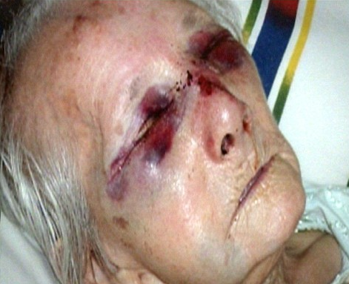
Photograph #1
Analyzing Media
By observing this photograph you can see that this elderly lady was abused. You can tell that she is in a huge amount of pain and wants relief. I can feel the emotion by just looking at her eyes. When I first saw this photograph I could feel the sense of emotion and pain she must be going through. I think the point of this photo is for us as viewers to feel what she is going through and also to want to help others who are being abused or neglected.

Slide 15
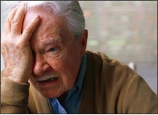
Photograph #2
This photograph gives me intense pain and suffering. I see a man crying for help but unsure of how to get it. I feel sympathy for this man and want to help him through his pain and suffering. I think the point of this photograph is to portray that many elderly people don’t know how to get help when they are being abused or neglected. I feel his pain and makes me want to reach out to him and help.

Slide 16
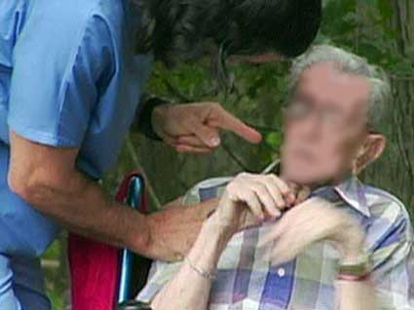
Photograph #3
By observing this photograph the man is getting verbally abused. He is disabled and can’t defend for himself. I get the sense of emotion behind this picture and feel his pain. By examining his face you can feel he is scared and has fear. I think this photograph should appeal to everyone’s emotions. The point of this picture is to say that neglect/abuse is a part of nursing homes and someone needs to stand for those who can’t stand for themselves.

Slide 17
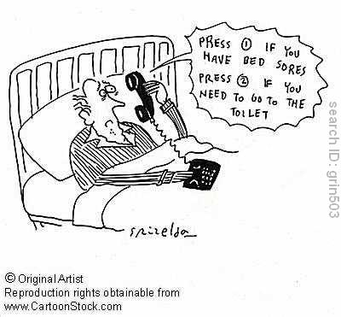
Cartoon #1
The message the artist is trying to say here is that there is a lack of personal attention when it comes to our bed ridden senior citizens. The illustration here is making light of the automated industry suggesting that it is difficult to actually speak to a live human being anymore!

Slide 18
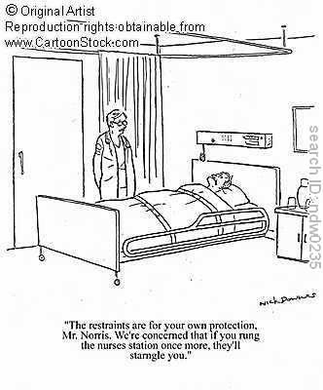
Cartoon #2
The message this cartoon is trying to send is that elderly people tend to be rather needy and are constantly wanting the attention of the staff. One solution to this problem is if the ratio of caregiver to resident was larger they would get more attention and therefore might not be so needy. On the other hand the flipside of this would be the nurses don’t want to give the necessary attention and therefore take steps to minimize their workload.

Slide 19
Advertisement #1
The advertiser wants us to believe that being family owned they will offer more personal care as if being cared for by family. By using words like quality and heart they are insinuating that your related benfit would be happier at this residence.

Slide 20
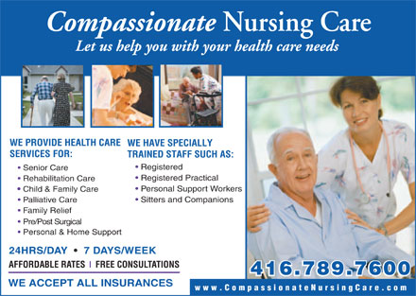
Advertisement #2
The ad wants the reader to know they provide quality care for many ages in different situations and purposes. They want us to believe that whatever the reason for us to be searching for a facility to provide nursing care, they can and will deliver it compassionately.

Slide 21
Editorial: If guilty the 2 former nursing home workers should get fair but tough punishment May 2009, Mountain Press
This case involved the abuse of two residents in a nursing home by two woman who had taken nude and embarrassing photos (Mountain Press).
“These senior citizens are at their most vulnerable, dependent on others for many tasks we take for granted. There is an inherent trust between resident and staff, between residents’ families and staff. Violate that trust and the reaction is swift and unforgiving” (Mountain Press).
The two employees were found guilty and they have ruined the reputations of nursing homes. Families are now scared of putting loved ones in nursing homes because of cases like this one (Mountain Press).

Slide 22
Here are the Statistics
“One to two million Americans over 65 have been abused, neglected, or mistreated by their primary caregiver”.
An estimated 50 percent of nursing home patients suffer from untreated pain.
“Twenty percent of reported elder abuse cases involve emotional abuse. Sixteen percent involve physical abuse. Three percent involve sexual abuse. Twelve percent involve caretaker neglect”.
One in three nursing homes across the country have been cited for nursing home abuse and other related infractions.

Slide 23
Conclusion
My first exposure of nursing homes was with my dad’s mom who lived the last six years of her life in one. And now, I’m experiencing it again with my mom’s mother, and to be honest with you, I never considered the fact that they might not be loved and cared for. It wasn’t until I chose this assignment did my eyes become open to the possibility that somebody could cause physical or emotional harm to my grandmothers.
After viewing photographs, cartoons, advertising, editorials, and statistics, nursing home abuse is very real and growing. It’s very difficult having to put a family member in a nursing home facility, not only do you deal with the guilt of placing your loved one in the care of strangers but you also have the added responsibility of making sure that the place you choose will give the kind of care as well as the respect and dignity you would give if you were able to care for them yourselves. Knowing abuse or neglect could possibly happen is always in the back of your mind, therefore should be something that you look for not only in choosing a facility but also when visiting your loved one after they have been placed there.
People go into nursing homes to be taken care of not abused or neglected.

Slide 24
Works Cited:
"Decubitus Ulcers/Depression." Moquin & Daley. Web. 31 July 2011. <http://www.moquindaley.com/depression.html>.
"Dehydration." Moquin & Daley. Web. 31 July 2011. <http://www.moquindaley.com/dehydration.html>.
Manf, Brand /. "Arizona AZ Nursing Homes Skilled Care Facilities Compare Ratings Directory Listings by County." Long-Term Care, Home Care, Assisted Living, Nursing Homes, Employment, Articles. Web. 31 July 2011. <http://www.carepathways.com/nhg-state-AZ.cfm>.
"Nursing Home Abuse Increasing - CBS News." Breaking News Headlines: Business, Entertainment & World News - CBS News. Web. 31 July 2011. <http://www.cbsnews.com/stories/2001/07/30/national/main304038.shtml>.
"Nursing Home Abuse Statistics | Elder Care Neglect Stats." Raleigh, Fayetteville, Accident and Personal Injury Lawyer, North Carolina Workers Compensation Attorney | Brent Adams & Associates. Web. 31 July 2011. <http://www.brentadams.com/library/nursing-home-abuse-statistics-elder-care-neglect-stats.cfm>.
"The Mountain Press - Editorial If Guilty the 2 Former Nursing Home Workers Should Get Fair but Tough Punishment." The Mountain Press - Local News, Classifieds, Businesses, Sports, in the Sevierville, TN Area. May 2010. Web. 31 July 2011. <http://www.themountainpress.com/view/full_story/3703102/article--Editorial--If-guilty--the-2-former-nursing-home-workers-should-get-fair-but-tough-punishment->.
Manf, Brand /. "Arizona AZ Nursing Homes Skilled Care Facilities Compare Ratings Directory Listings by County." Long-Term Care, Home Care, Assisted Living, Nursing Homes, Employment, Articles. Web. 31 July 2011. <http://www.carepathways.com/nhg-state-AZ.cfm>.

